Slide 1
Executive Summary
File created on: 10-07-2023 10:52:38

Slide 2
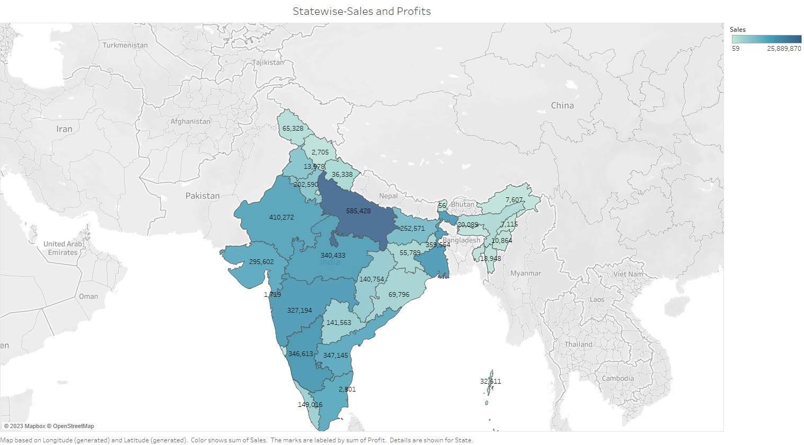

Slide 3
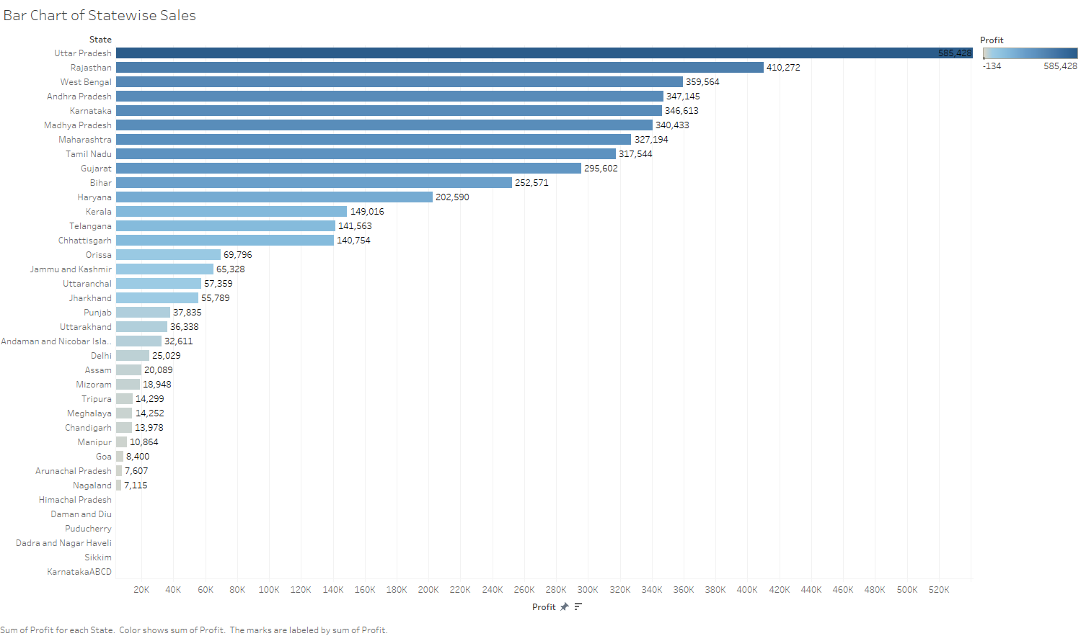

Slide 4
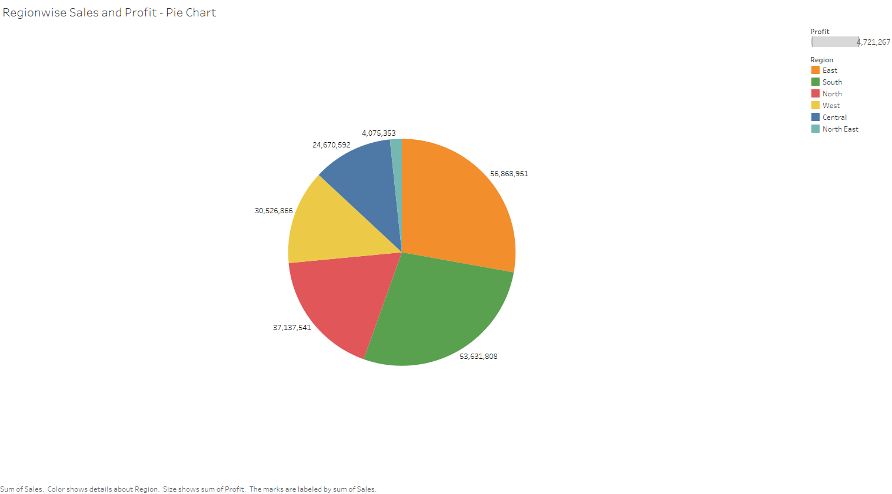

Slide 5
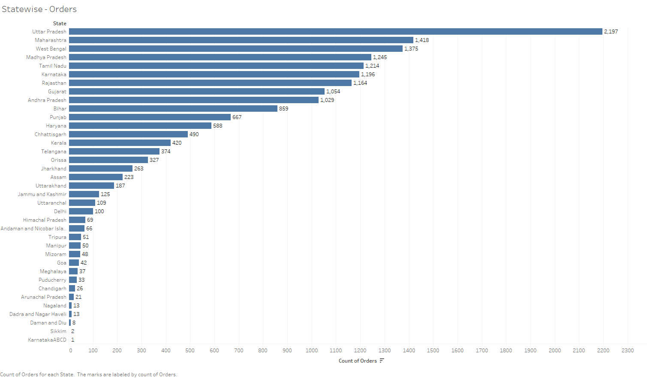

Slide 6


Slide 7
